Slide 1
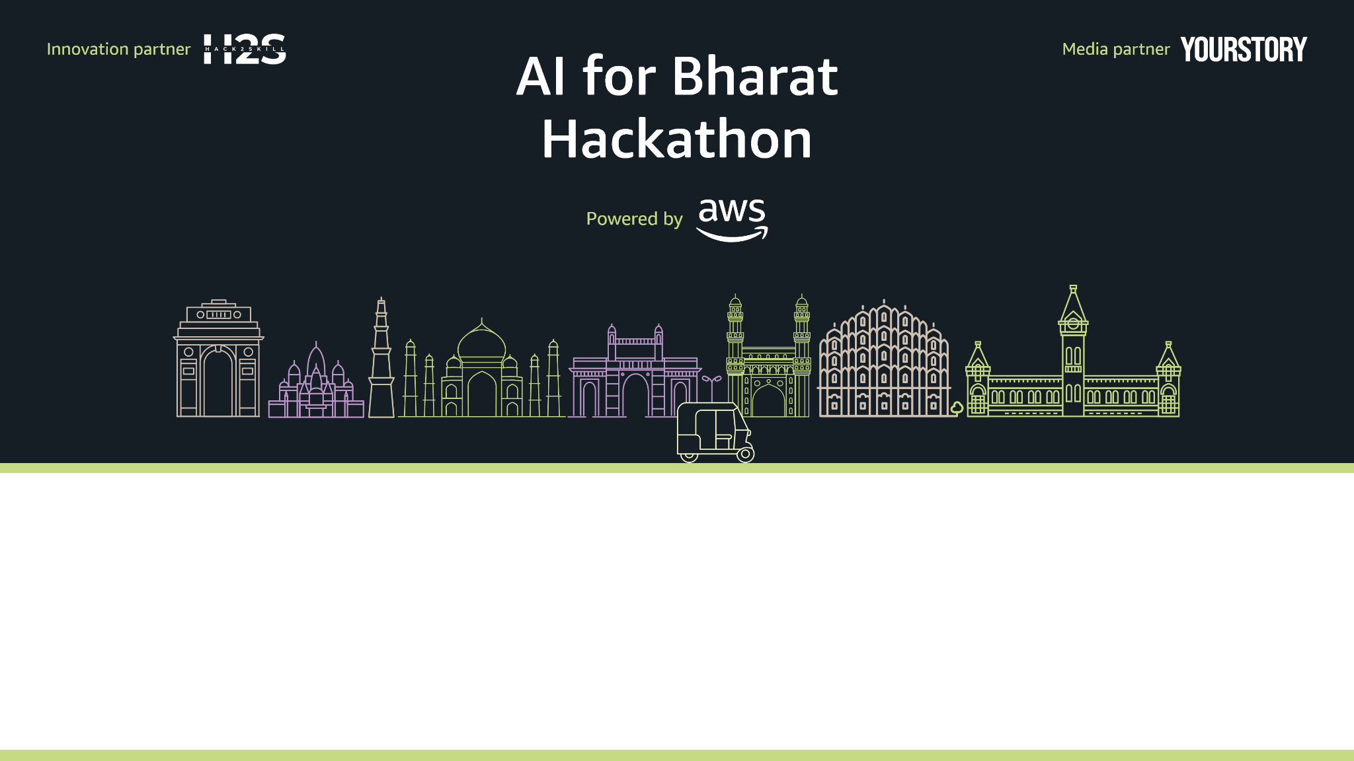
Team Name : LearnAI
Team Leader Name : Pradipti Kayal
Problem Statement : AI in initial health analysis

Slide 2
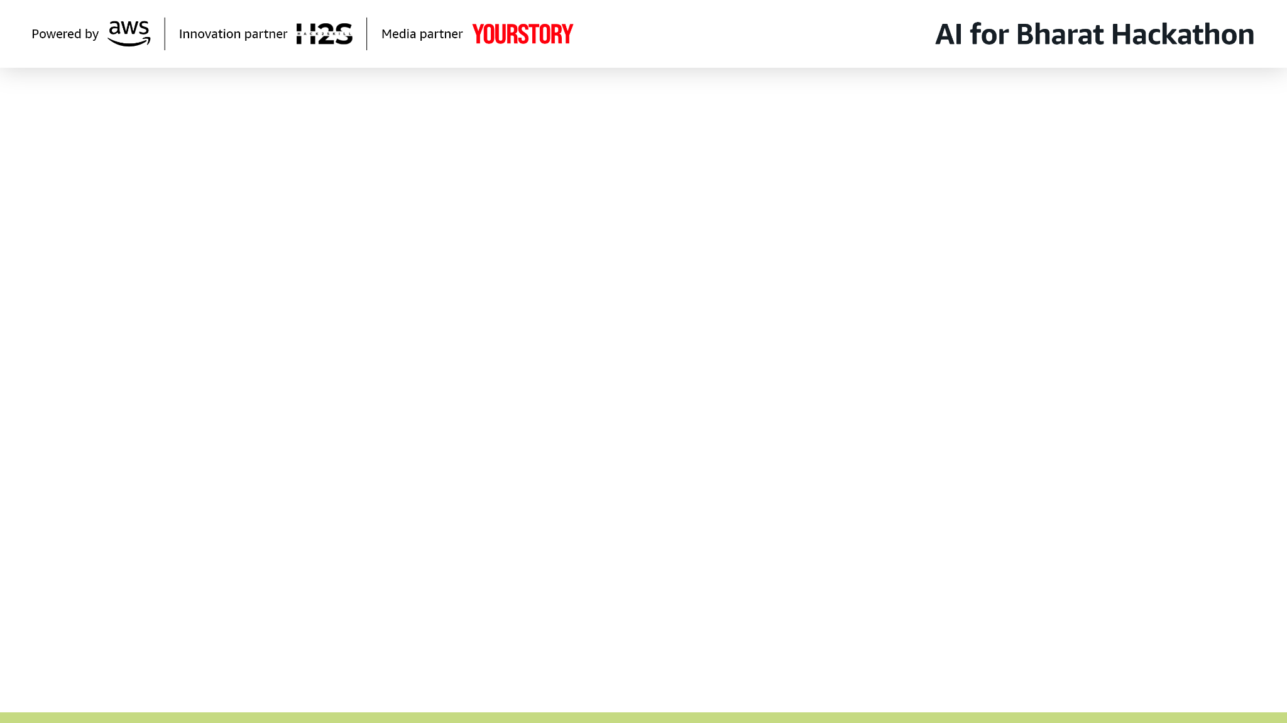
Brief about the Idea:
An AI-powered system that generates a preliminary diagnosis and prescription based on patient symptoms and medical history. The output is then verified and approved by a licensed doctor, ensuring safety and accuracy while reducing the burden on healthcare professionals.

Slide 3
How will this help:
Unlike symptom-checker apps, this system produces both a diagnosis and a draft prescription.
It integrates seamlessly with doctors’ workflows, acting as a supportive tool rather than a replacement.
Focused on India’s healthcare challenges — multilingual support, low-bandwidth accessibility, and integration with telemedicine platforms.

Slide 4
List of features offered by the solution
Symptom input via text, voice, or structured forms.
AI-generated preliminary diagnosis.
Draft prescription with dosage suggestions.
Doctor dashboard for quick review and approval.
Patient-friendly interface with reminders and follow-ups.
Secure data storage and compliance with medical privacy standards.

Slide 5
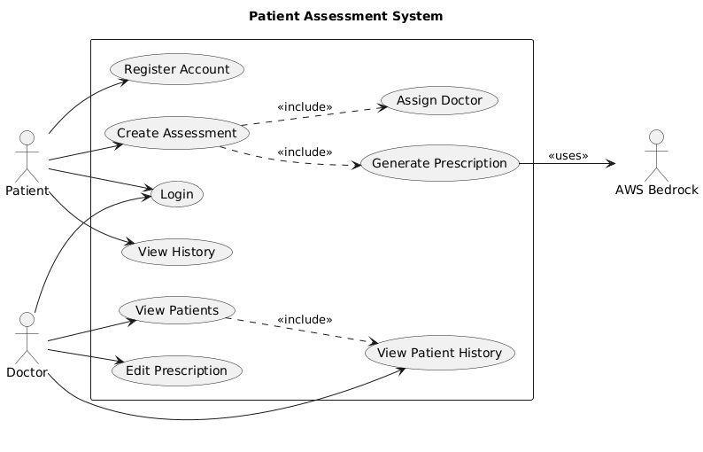
Process flow diagram or Use-case diagram

Slide 6
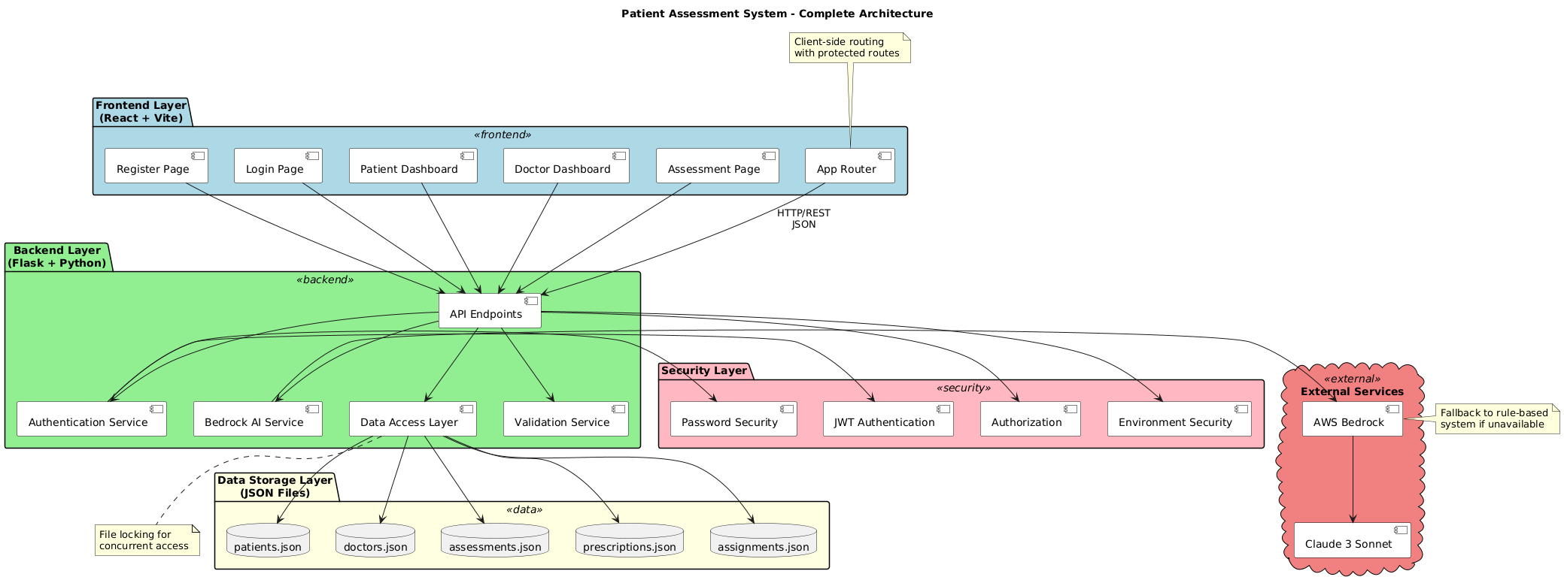

Slide 7
Technologies to be used in the solution:
AI/ML: Amazon Bedrock Claude
Cloud: AWS, DynamoDB, S3
Frontend: React+Vite
Backend: Python+Flask
Security: JWT auth

Slide 8
